Slide 1
Food and Beverage Management fifth edition
Chapter 2
Concept Development

Slide 2
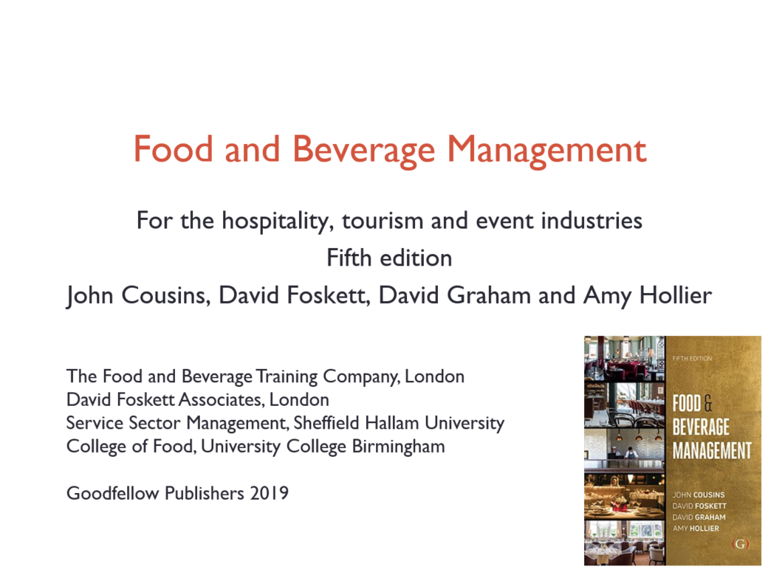

Slide 3
Chapter 2 covers:
Developing a consumer–product relationship
Market research
Market segmentation
Idea evaluation
Completing the concept development
Setting goals and objectives

Slide 4
Considering the consumer
Consumers are sophisticated, complex and dynamic
The nature of the consumer is continually changing
Without the consumer there is no link between the needs people have and the food and beverage product

Slide 5
Considering the product
Key questions:
  Who are the consumers?
  What products do they want?
  Why, when and where do they want a food and beverage product?
  How do they obtain a food and beverage product?

Slide 6
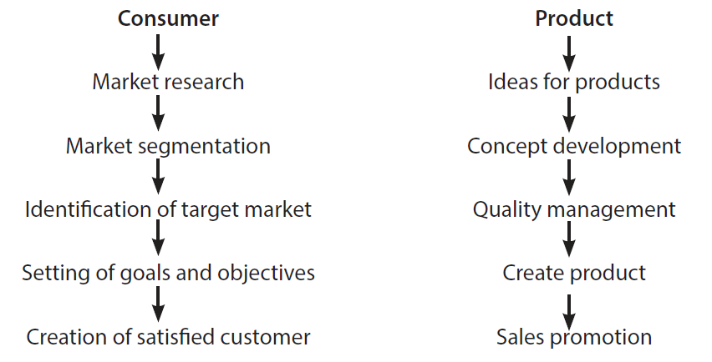
Consumer and product frameworks

Slide 7
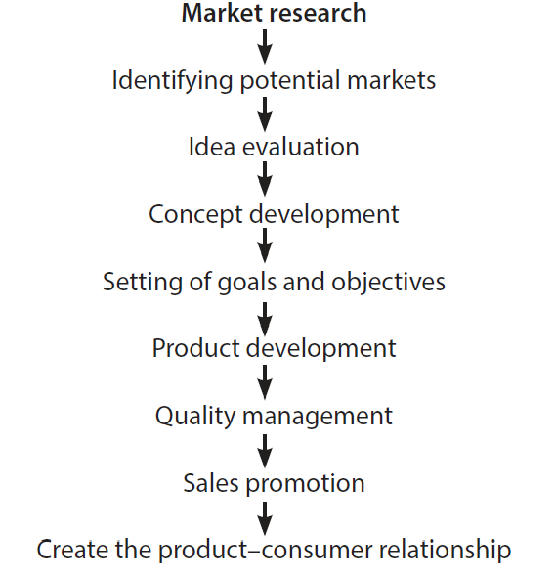
Single product-consumer framework

Slide 8
Market research can include:
Consumer panels; Questionnaires; Interviews
Mystery customers
Sales analyses
Data capture from social media sources
Market information from specialist publications
Generally available data especially from internet sources

Slide 9
The nature of demand
Food and beverage demands are wants for specific food and beverage products
Consumers have a variety of goals when they decide to choose a food and beverage product
Individual consumers have different priorities

Slide 10
Different food service operations:
Are designed for the:
  Needs people have at the time
  Rather than for the type of people they are
The same customer can:
  Be business customer during the week
  A member of a family at the weekend
  Wanting a quick lunch or snack while travelling
  Be organise a special event

Slide 11
Choices can be based on:
Price - the amount of money required to purchase the product
Cost - is not just the price but includes all costs
Worth - perception of the desirability of a particular product over another
Value - the personal estimate of a product’s benefits and a perception of the balance between worth and cost

Slide 12
Cost is not just the price
It also includes the cost of:
  not being able to go somewhere else
  transport costs
  time
  having to look and behave a certain way in the venue
  being disappointed

Slide 13
Value is a personal judgement
Good value is where the worth is perceived as greater than the costs
Poor value is where the costs are perceived as greater than the worth

Slide 14
Market segmentation
Various ways to segment markets include:
  Geographic
  Demographic
  Psychographic
  Behavioural
Adopting this approach assists in the identification of consumers with similar needs, wants and demands

Slide 15
Change is a continuous
Market segmentation is a useful generic grouping to use for marketers
New groups are continually forming and older ones becoming no longer relevant
The need to make identify is continual

Slide 16
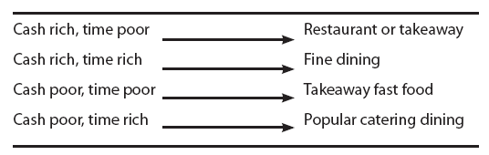
Cash/time model

Slide 17
Segmentation based on typologies
Groups of consumers can be categorised, named and targeted, for example:
  Empty nest career ladies
  Comfortable retired couples
  Stretched single mums
  Career focused females/males, or
  Competitive male urbanites

Slide 18
Segmentation based on generations
Baby Boomers
Generation X
Millennials
Generation Z
Snowflakes
Despite the differences, there is an underlying trend of increasing unity in common causes such as environmental concerns, humanitarianism and animal welfare

Slide 19
Idea evaluation
Techniques can include:
  Management and staff brainstorming
  Survey of customers
  Evaluation of existing products
  Evaluation of competitors products

Slide 20
Idea screening
Example questions can include:
  Does the idea meet consumers’ needs?
  Is the group of potential consumers large enough?
  Can the operator deliver the idea?
  Will the idea generate customer satisfaction?
  Are there benefits to the operation, economically, managerially and socially?
  Is the idea different from the competition?

Slide 21
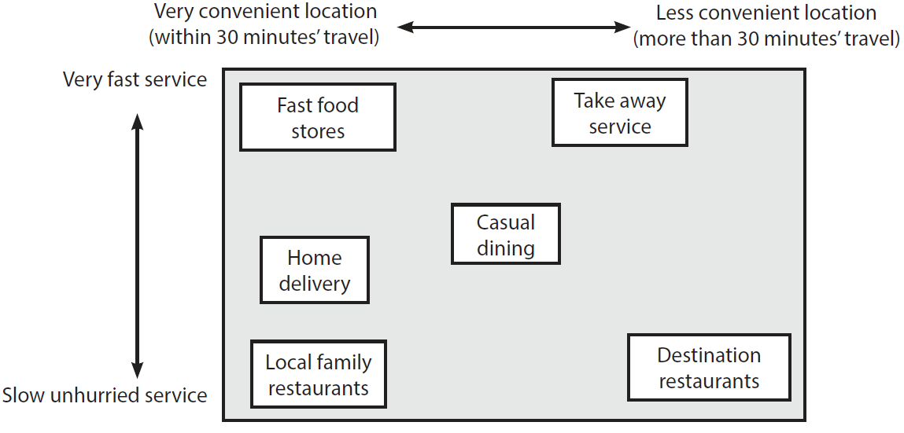
Perceptions of various products

Slide 22
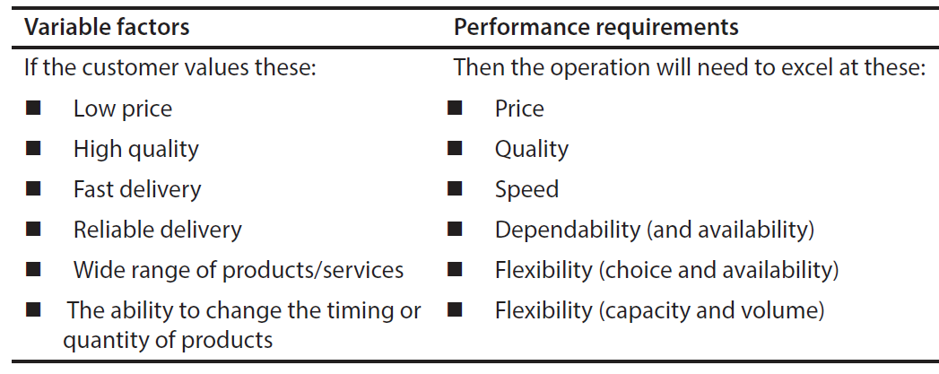
Required performance factors
Source: developed from Slack et al. 2013

Slide 23
Concept testing
Testing in the field and asking customers:
How they view the concept in relation to the competition?
If they would purchase the product and how frequently, time of day, and what price might they be prepared to pay?
What they see as the benefits of the product?
What improvements to the product could be made?

Slide 24
Setting goals and objectives
Goals, or aims, are the broad intentions of an organisation
Objectives are the measurable outcomes and include:
  Economic objectives
  Managerial objectives
  Social responsibility objectives
Objectives for an enterprise tend to be a mixture of these

Slide 25
The need to set objectives
The goals of a food service organisation affect the strategic options and the objectives
Objectives have an impact on the planning to achieve the goals
Objectives provide the basis for reviewing the performance of the organisation against and outcomes are used when making future strategic choices

